Slide 1
Bootcamp Project 1
Luke Siljander Edison Yang
Nicholas Logan Heather Foxhill

Slide 2

Design and Style Library Heather Foxhill
Automatic Modal for User Input
Style Library
Progress Bar
Navigation bar
Quiz Form Layout

Slide 3

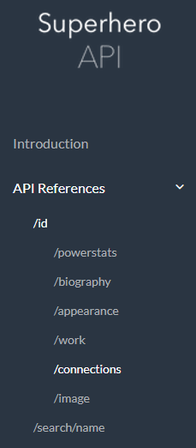
APIs Edison Yang
Superhero API
Utilized to gather Character images and data
Comic Vine API
Utilized to retrieve Character Descriptions

Slide 4
Quiz Logic Nicholas Logan
Arrays
Character
Question
Answer

Slide 5


Firebase & Heroku Deployment Luke Siljander
Firebase – Database
Heroku – Site Deployment

